Slide 1
Microneedle patches for dermal drug delivery and bioanalytical applications
Keng Wooi Ng PhD School of Pharmacy, Newcastle University
keng.ng@newcastle.ac.uk
@ngkengwooi
blogs.ncl.ac.uk/kengng
1
nanoLAB Lunchtime Seminar | Newcastle University | 28 March 2018

Slide 2
Objectives
Overview of microneedle patch technology
Challenges & opportunities (C&O’s)
Collaborations
Technology refinement
New applications

Slide 3
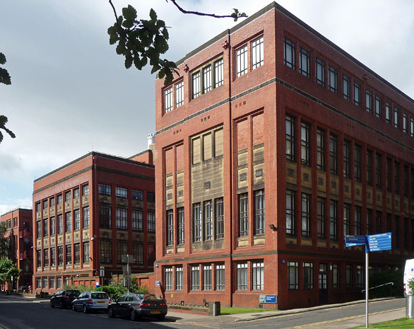
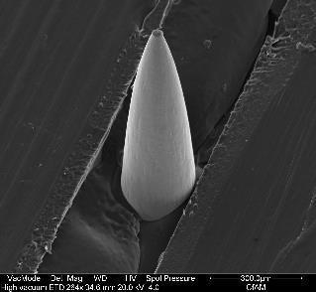
Microneedle patch
Ng et al. Drug Deliv Transl Res, 2015

Slide 4
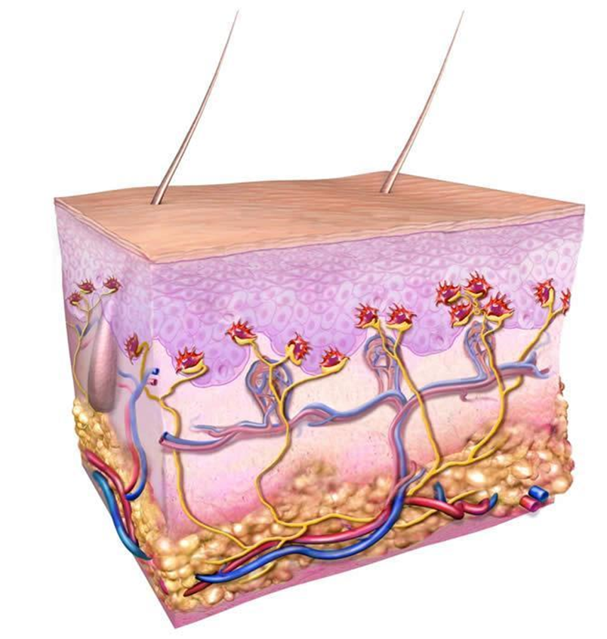
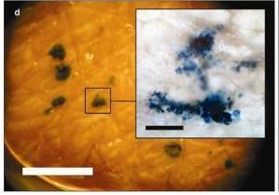
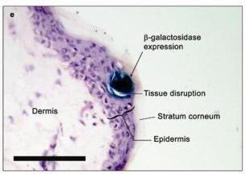
Applications
Drug delivery
Diagnostics
Biomarkers
Skin barrier
Drugs
Advantages:
Minimally invasive (painless, bloodless)
Accurate tissue targeting
Ng et al. Vaccine, 2009

Slide 5
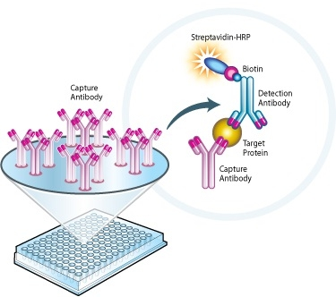
Immunodiagnostics: Principle
Microneedle-based ELISA (‘MELISA’)
Miniaturised quantitative immunoassay
Based on sandwich ELISA
Detection antibody + enzyme conjugate
Chromogenic substrate solution
Microneedle
Antigen
Capture antibody
Antigen capture
Antigen detection
Signal

Slide 6
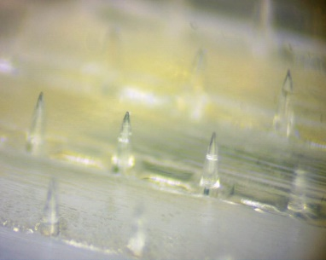
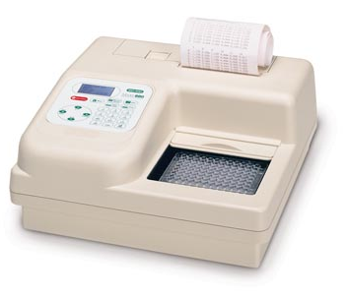
Immunodiagnostics: proof of principle method 1
Problems:
Signal dilution
Matrix effect
C&O:
Novel analytical platform development
Ng et al. Drug Deliv Transl Res, 2015

Slide 7
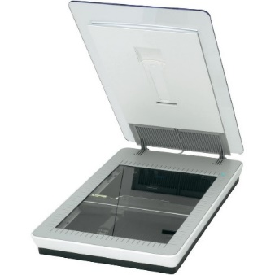
Immunodiagnostics: proof of principle method 2
Binary classification test Qualitative (biomarker detected, or not)
2D signal generated at microneedle tip only ~ skin depth
Concentrates signal
Paper-based, facile, low-cost

Slide 8
Immunodiagnostics: proof of principle method 2
Multiplex detection Simultaneously analyse multiple biomarkers
Incorporate experimental controls
Quantification?
C&O:
Quantify, digitise, 2D → 3D

Slide 9
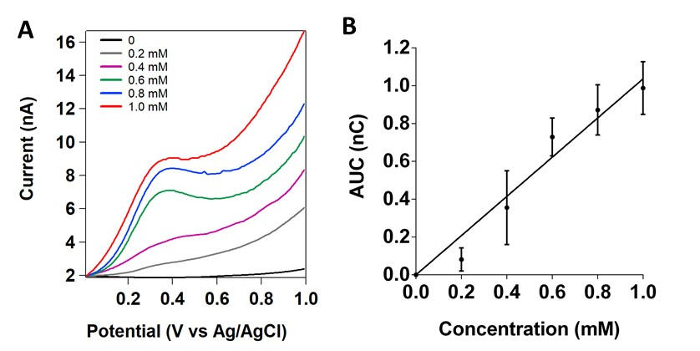
Immunodiagnostics: future directions
Current time to result: 3–5 hours from skin insertion
Can we make it real time?
In situ measurement – electrochemistry
Vitamin C – NOT immuno
C&O:
Novel analytical platform development (lab on a chip)
Clinical applications

Slide 10
Summary & discussion
Minimally invasive microneedle technology
Accurate targeting of epidermal and dermal tissue
Drug delivery and bioanalytical applications
Challenges (opportunities) in bioanalytical applications:
Microfabrication
Signal quantification
Real-time detection
Device validation
Lab on a chip
Keng Wooi Ng
keng.ng@newcastle.ac.uk
@ngkengwooi
blogs.ncl.ac.uk/kengng

